Slide 1


UKA TARSADIA UNIVERSITY
DIWALIBA POLYTECHNIC
Summer Internship
Presented by:-
Raj Lad (202002100710003)
Harsh Patel (202002100710012)
Malav Pancholi (202002100710016)
Kashish Rajyaguru (202002100710034)
IT 5th sem
Guide By:-
Ms. Jayshree Patil
Assistant Professor
IT & CE Department
Diwaliba Polytechnic,UTU

Slide 2
Outlines:-
Company Profile
Week wise timeline chart
Area of internship
Technologies
Week wise learning
Conclusion
References

Slide 3
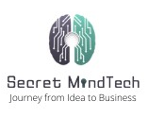
Company Profile
Company Name: Secret MindTech.
Secret MindTech is the best software company, which provides better customer service with the right team of experienced Employees and experts to fully meet your requirements.
At Secret MindTech, they provide the best IT solutions which allow you to work smarter. Here they provide the best customer services and IT solutions to make your work easy and effective with an Experienced Employee team.

Slide 4
Timeline Chart
Learn about various types of Digital Marketing
Made a report on negative points of website
Content & Blog writing
May 16
May 30
Week 1
2
3
4
5
Successfully completed Internship
Start
May 23
June 06
May 09
Keyword planning & Sorting
Implementation on Website & SMO
Discussion about Digital Marketing

Slide 5
Area Of Internship
Digital Marketing
In Summer vacation we have learned about Digital marketing & SEO (Search Engine Optimisation).
We have also learned about Basics of SMO & SMM (Social Media Optimisation & Social Media Marketing).
We completed many tasks given by Internship Guide (Mr. Preet Patel).
We have created Blogs for company’s Website and also made content of different parameters of company services.
After that we have implement content on company’s website which we have created during internship period.

Slide 6
Technologies
Online Platforms:-
SEO-Quake
Google ads
Google analytics
Ginger grammar
SEObility
Google Keyword planner
EDraw-Max

Slide 7
Week wise Learning
Week 1:
In the first week, we have learned about digital marketing. The simple concept of digital marketing. “SEO”: On-page SEO/OFF page SEO, Overview of search engine work, Google search console, On page SEO factors, How to check mobile Responsive Website & Canonicalization issue, sitemap. Types Of sitemap: XML/HTML, Redirection:301/302, SEO friendly URLs, ALT text in SEO, SSL Certificate in SEO & Types of SSL Certificates and also made a short Note on that Each & every topic That we have learned in first week.
What is digital marketing (spamming)?
Marketing using digital or electronic devices and the internet.

Slide 8
Week 1 cont..
Channels of digital marketing.
SEO (Search Engine Optimization) (putting efforts manually (not paid))
Showing your website as a top website using keywords searched by any user.
It works organically (without paying to search engines ).
SEM (Search Engine Marketing)(Paid efforts)
Showing Web results using a paid label or Ad label.
Social Media Optimization
Redirect the users to your websites using social media
Use social media profile to represent your business
Post everything as scheduled.
Social Media Marketing
Posting on social media using a sponsored label(paid)
Email marketing
Sending Mails to existing audiences and new audiences for interaction (marketing through EMails).
Content Marketing
Process of making valuable and relevant content to attract and engage with an audience
Affiliate Marketing
Selling products online by taking a commission from dealers.
Influencer Marketing
This is a process of promoting and selling products with influencers and attracting the target audience

Slide 9
Week 1 cont..
SEO (Search Engine Optimization)
In 1991 the first website was created and SEO was founded
After that, too many websites were created
Structure and accessibility needed to access those website’s content
First Search engine: YAHOO
After that in 1996 larry page & brin build ‘Back Rub’ named a search engine which is now known as ‘GOOGLE’
SEO is a process to increase the number and quality of users to websites by an algorithm using keywords.
Types of SEO
On page SEO (relate to the content on the Website(editing on Webpage))
Off Page SEO(make the relationship strong of our website with another website (backlinks))
Factors of on page SEO:-
A website should be crawlable(check Bots, Robots, etc) User-friendly URL, Well targeted contents, Keyword optimization, HTTPs, Image optimization, Click through rate, Mobile friendly, Quality outbound links (where the referral link going through ), Website structure

Slide 10
Week 1 cont..
Crawler:-
Scan the Website Word by Word if it finds any back link then the crawler follows the link and goes to that particular website then checks it.
This process is a very time taking process.to overcome this situation just go to GSC (Google Search console) and submit your website.
All the crawled information will be stored in Local Server. There is no structure available in Local Server.
Keywords for on-page
Title Tag ( Page Title) (20-40 %)
Description (first 50%)
H1 tag ( for giving structure to website ) (giving information about content )
Formatted text ( formatting text (bold,italic,underline) )
Outgoing links (links for other pages mentioned in website)
URL -> ( domain,subdomain,folder name or page name)
Alt tag ( graphics )
Content.

Slide 11
Week 1 cont..
Sitemaps:-
Makes crawling & indexing easy for crawlers.
Sitemaps are hierarchical forms of your website.
It shows which page is connected with the other page.
Site maps can be in two ways.
Simple way and hierarchical way.
In a simple way crawler will go to another page through inlinks. It is a very complex and time consuming process. In this process maybe some pages remain crawling.
Hierarchical way is easier than the simple way it shows hierarchically where to go next
XML Sitemaps:-
XML Sitemaps are basically written for search engine spiders.
Using XML sitemap a search engine spiders can easily and quickly extract all important pieces of information about your site
HTML Sitemap:-
HTML site map helps lost users to find a particular page on your website

Slide 12
Week 1 cont..
SSL certificates:-
On 6 August 2014, Google said that the Website with an SSL certificate (https://) will get more advantage in the Search Engine Result Pages (SERPs).
If your website is SSL certified then the user will feel more secure and feel free to make any transaction or give details about themselves.
This is indirect factor to rank of website
SSL Certificate will be more effective to rank higher .
Types of SSL certificate:-
Single domain SSL Certificate
Not work on any subdomain.
Only for the main domain.
Multi domain SSL Certificate
Applicable for multiple domains.
Wildcard SSL Certificate
Cover all domain on single root domain
Organisation SSL Certificate
Works as a single domain, authenticating details of organisation.
Extended SSL Certificate
Big websites use this type of Certificate

Slide 13
Week 2
In the second week we have learned about Searcher’s Intent, Difference Between Keyword & Query, Understanding SEOquake, Multiple Keywords in a single post,Bounce Rate, That I have learned in this week also done Keyword planning and sorting & Also made An Excel sheet of keywords Using different tools.
Searcher’s Intent
Searcher’s intent is needed to increase the ranking of a website.
Type of searches
Informational (detailed information about query) ( more important for SEO)
Navigational (search page direct )
Transactional ( for buying something )
Commercial ( for selling something )
Local searches ( nearby searches )
Query & Keyword:-
Query is for Users
Keyword is for marketer
User searches query
Marketers use keywords to rank websites.
Query can be used to derive keywords from GSC (Google Search Console).

Slide 14
Week 2 cont…
Link Building & link Earning:-
During 1995 - 2000 google considered link building and link earning same.
Link Building (Banned )
Creating links theself like paid links, fake links, resi broker link etc.
Building links
Article submission
Spam emails
Reciprocal linking
Link Earning
Post anything on internet and people like that , then it gaining backlinks automatically is called link earning
Content curation
Guest blogging
Personalised email outreach
Building partnership
Bounce Rate:-
If any user comes on your website and gets some information and does not go deep and not go to any external links and go back to SERP then it'll be known as Bounce Rate.

Slide 15
Week 2 cont…
E-A-T in SEO (Expertise, Authority, Trust):-
Expertise:
Search engines will check the bio and background of the author with the presence of particular data.
Authority:
Links given in blog posts for confirmation of numeric data, those links will give Google a signal that the given numeric data is true.
Trust:-
The search engine will check the interaction with your blog post
We have created report on negative points of company’s website individually and also we analise keywords and sort them by search rate & traffic.

Slide 16
Week 3
In the Third week we have Completed Keyword planning and sorting & started working on the website of Secret MindTech to Improve SEO rate of the website. In order to improve the SEO Firstly we have Listed out all the negative points of the website which we have already done in second week and started Designing title Tag and Description of Service page & Home page also found content for those pages, made description about Web designing , Mobile app development, Digital marketing & product Development for service page, SERP for service page, About us section planning, wrote blog on : Web designing/software & Software engineering/ Requirement Engineering/software development life cycle.
Negative points of the website:
Description is missing
Title is missing
Keywords are missing
Website does not have any structure
Heading Tag is missing.
No Keyword in details
Redirecting button over specified
8. Same detail specified in 2 different pages
9. This is mobile friendly website but taking longer time for loading (missing AMP)
10. Some keywords are used in about us section
11. Contact us button not working
12. Proper ALT Text not used (34 image pending)
13. Lack of backlink (only 2)
14. Lack of Keywords (Only 4 (India))

Slide 17
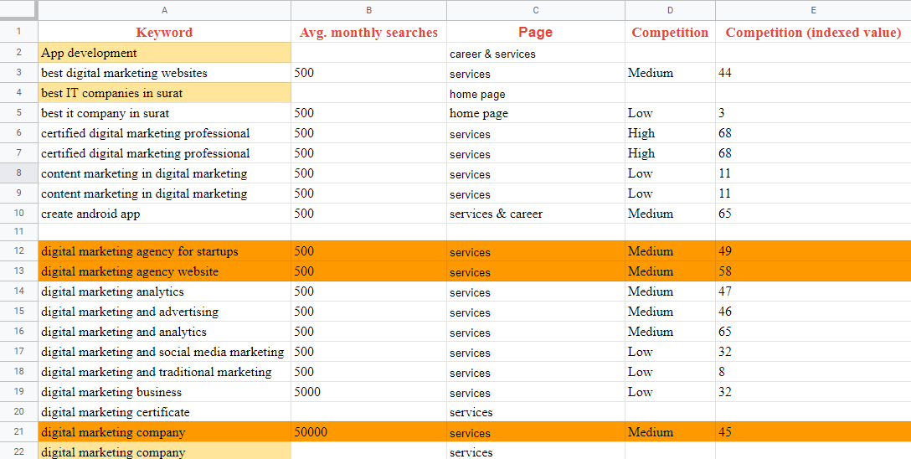
Week 3 cont…
Fig. Keyword planning

Slide 18
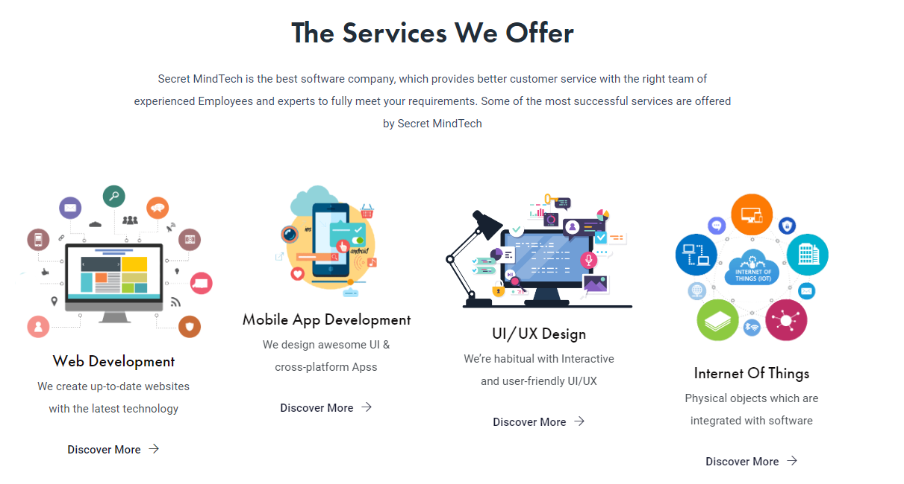
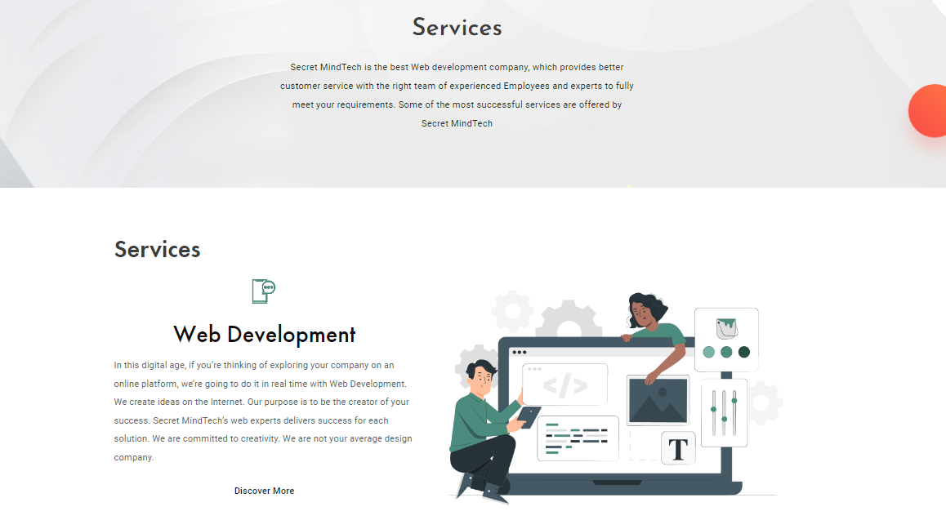
Week 3 cont…
Fig: content writing home page
Fig: content writing service page

Slide 19

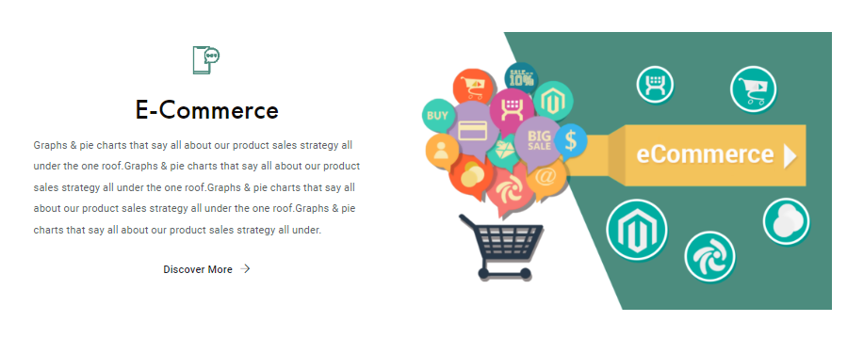
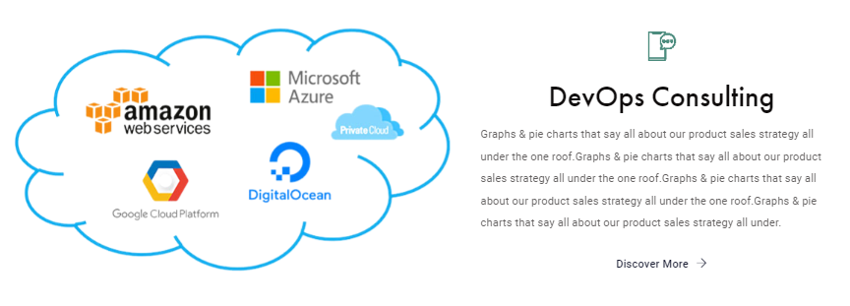
Week 4
Completed content making about E-commerce, DevOps Consulting, UI/UX Developer, Blog Making for the blog section of the Website. wrote blog on : Digital marketing with basic SEO/Importance of graphic design./product development by Secret MindTech/E-commerce.

Slide 20
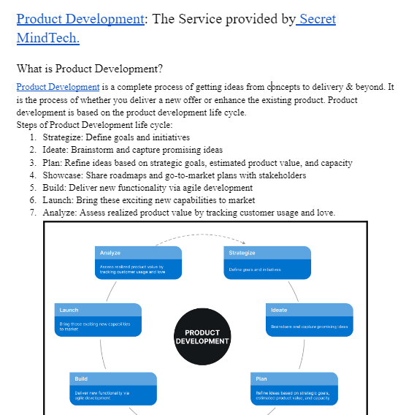
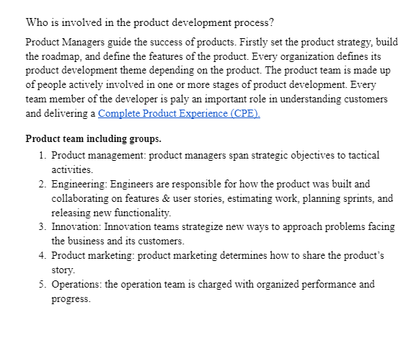
Week 4 cont..

Slide 21
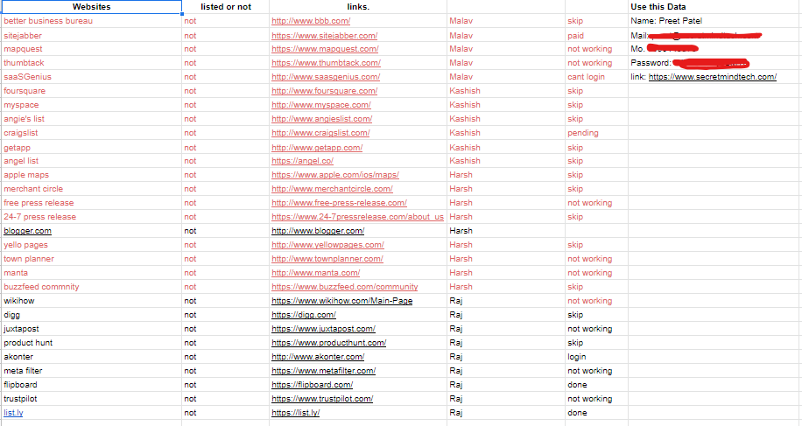
Week 5
In the last week we have found various social media platforms for social media optimization and Learned how actual social media optimization is & sorted the list of various social media platforms for organic marketing and Started making accounts on those various platforms, At last we learned about social media marketing Which is paid, not Organic & completed the theory content.

Slide 22
References
https://freetools.seobility.net/en/seocheck/staging.secretmindtech.com
https://ads.google.com/intl/en_in/home/tools/keyword-planner/
https://neilpatel.com/blog/seo-essentials/
https://www.wscubetech.com

Slide 23
Thank You !

